Slide 1
Module 1.4:
Neural Networks and Deep Models
Multi-layer Perceptron; ConvNets
ML for Cybersecurity

Slide 2
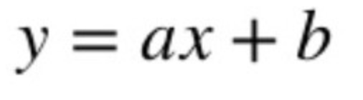

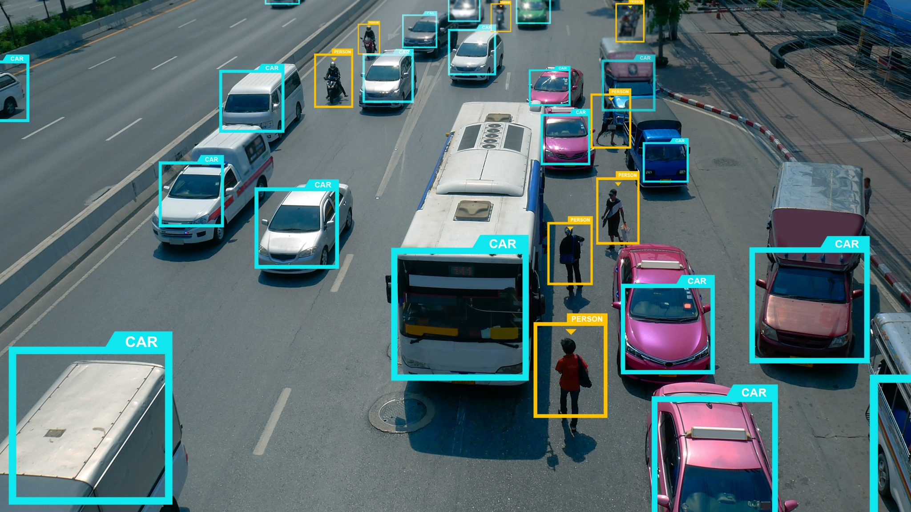



Slide 3
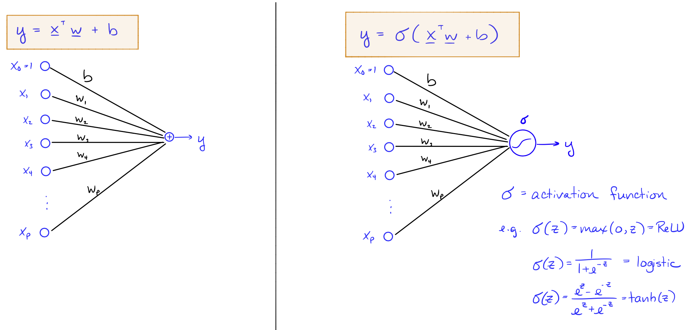
A Simple Neural Network

Slide 4
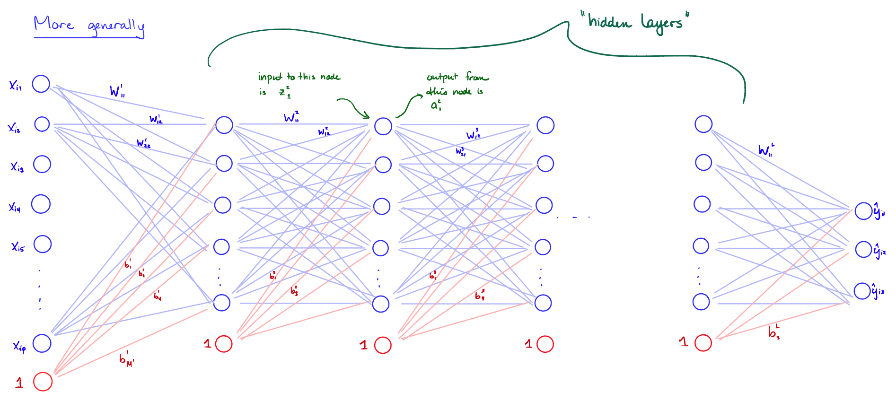
Multi-layered Networks (e.g., Perceptrons)

Slide 5
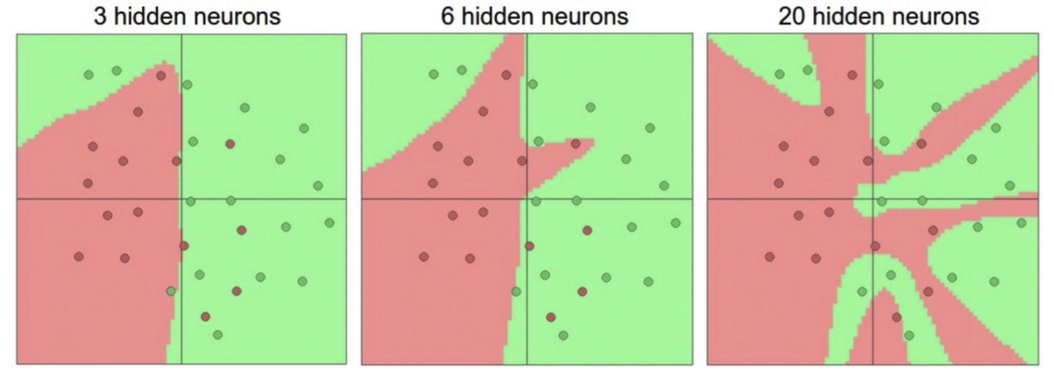
Representation Power
Neural network with one hidden layer is a universal approximator (can represent any function)
The capacity increases with more hidden layer and hidden units

Slide 6
Training Multi-layered Networks: Optimization
Neural nets can be trained via stochastic gradient descent
For deeper neural network, one can updates the weights via backpropagation
Initialization of neural nets
Initializing weights
usually initial weights are chosen to be random values near zero
Scaling input:
Standardize all inputs to have zero mean and standard deviation = 1 (making it easier to choose a good range of initial weights and easier to regularize)

Slide 7
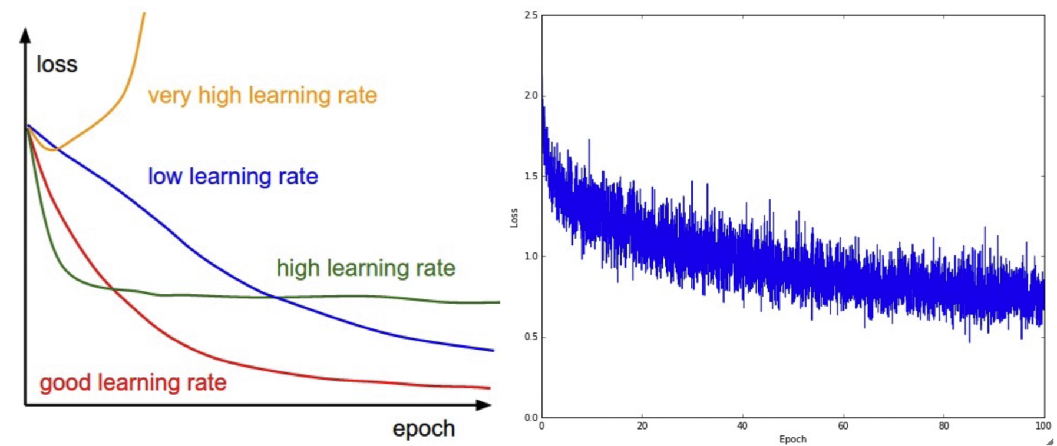
Training Multi-layered Networks: Learning Rate
How often to updates weights
Update weights after utilizing every mini-batch of training examples (i.e., an epoch)
How much to update
Learning rate effect

Slide 8
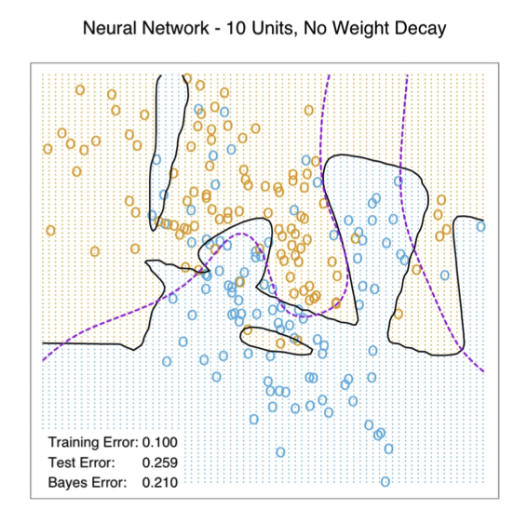
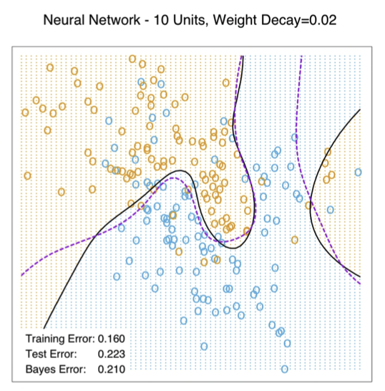
Training Multi-layered Networks: Overfitting
Early stopping
Train the model for a while but stop before convergence
Weight decay
Adding regularization to loss function
Encouraging models with “small” weights

Slide 9
Deep Models

Slide 10
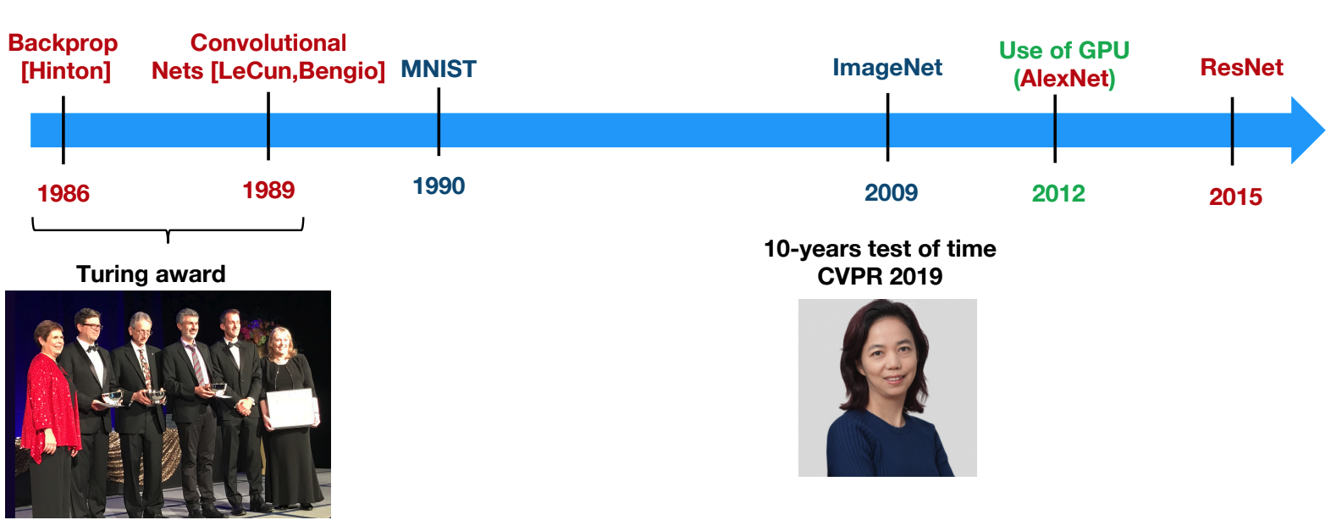
Pillars of Deep Learning

Slide 11
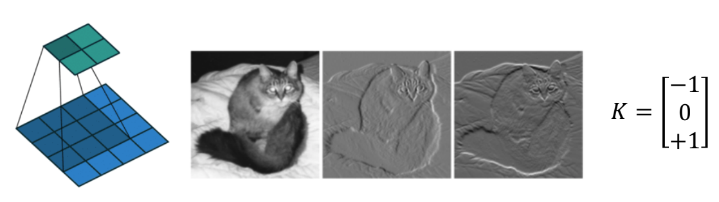
Convolutions
Convolve image with a filter
Typically, features were hand-crafter (HOG, SIFT, LBP, ...)
DCNN allows learning the features

Slide 12
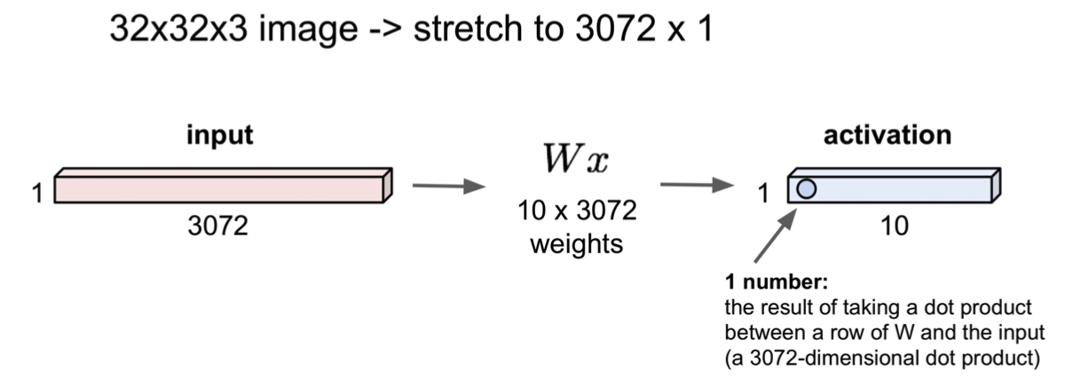
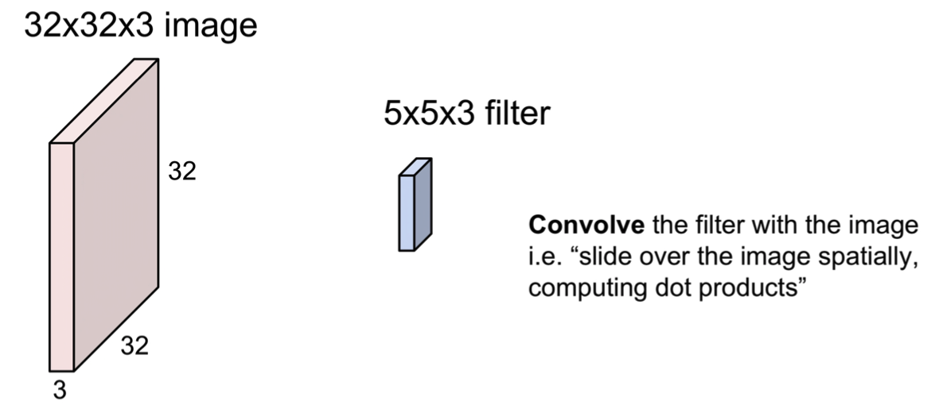
Convolutional Neural Nets
Fully connected layers
Convolutional layers
Credit: http://cs231n.stanford.edu/slides/2018/cs231n_2018_lecture05.pdf

Slide 13
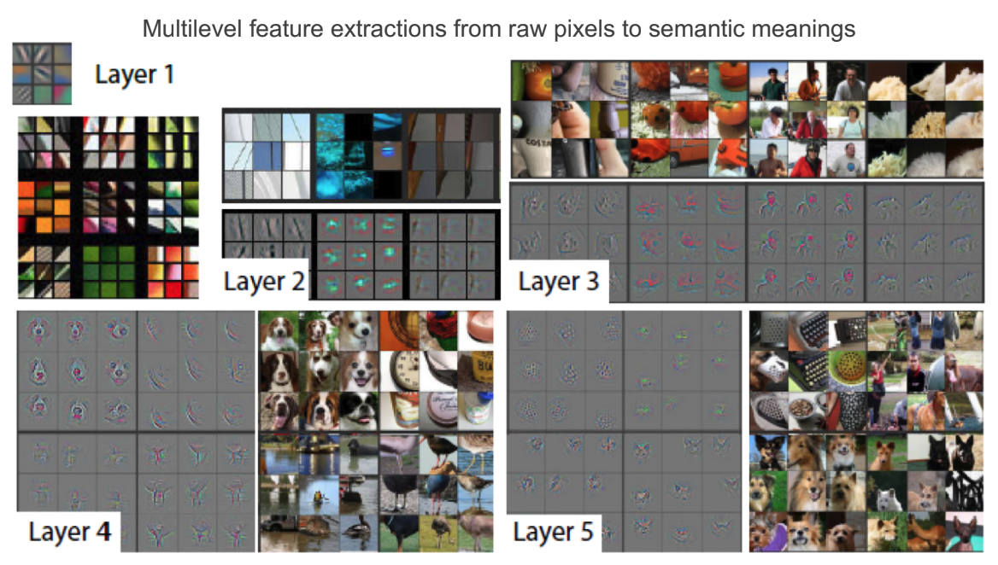
Convolution Layers

Slide 14
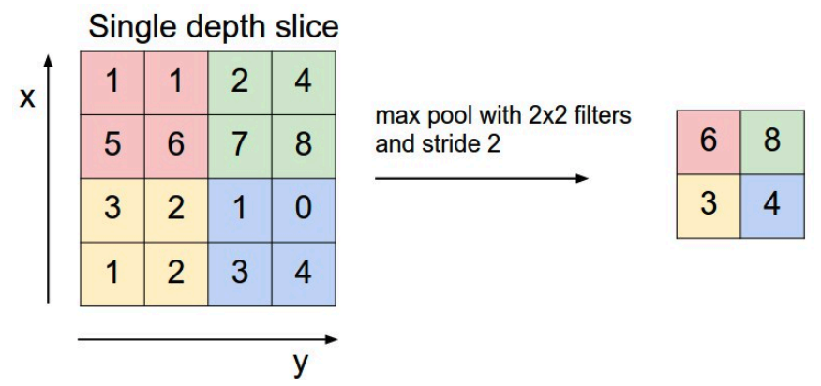
Pooling: Reduce Dimension
Subsampling: average over patches
Max-Pooling: maximum over patch — better in practice

Slide 15
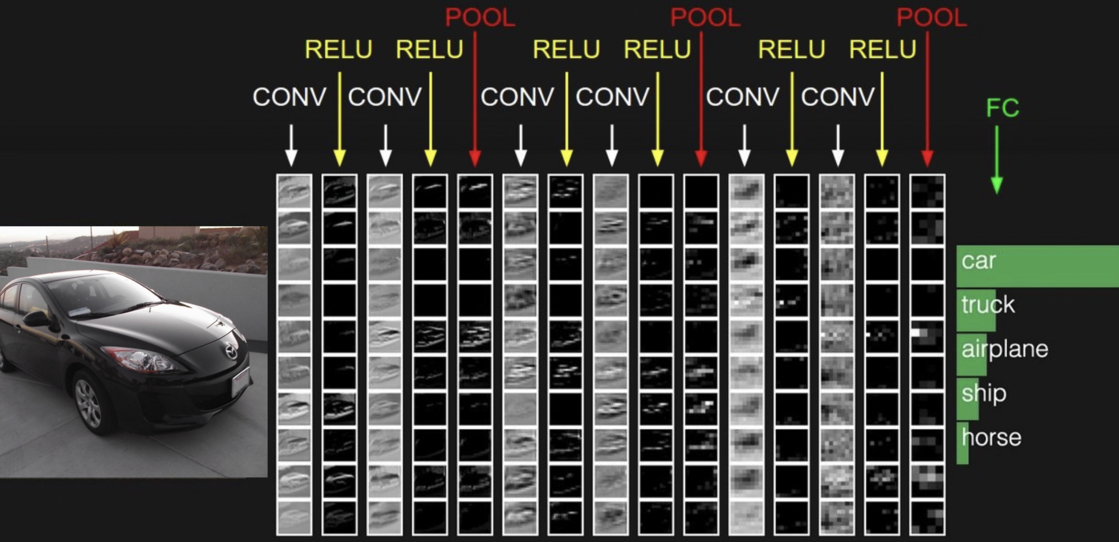
Example

Slide 16
Concluding Remarks
“Deep” models as powerful tools for learning representations
Multi-layer perceptron (generic statistical multi-layer/“deep” models)
Convolutional neural networks (images)
Convenient when the training data is
High-dimensional: DL as dimensionality reduction tools
Structured: DL learns a compact numerical representation
Massive: DL requires a large volume of training set

